Slide 1

Project Management Framework

Slide 2
Objectives
Enterprise Environment Factor
PMIS
Organizational Process Asset
Definition of a project and Constraints
Organizational Structure
Matrix (Strong, Weak, Balanced)
Functional
Projectized
Project-based organization
Organizational Hierarchy
Tight matrix
Project Life Cycle
– Predictive, Incremental, Iterative, Adaptive
Work Performance Data and
Information
Stakeholder Management
Operational work
PMO (Supportive, Controlling, Directive)
Program, Portfolio Management

Slide 3
Content
Project
Program & Portfolio
Project Management Office
Operation
Project Manager
Organizational influence on Project Management
Project Life Cycle
Project Element

Slide 4
1. Project

Slide 5



Overview
A project is a temporary endeavor undertaken to create
a unique product, service or result
Temporary
endeavor
Unique (product,
service, result)
Progressively
elaborated

Slide 6
Overview
Has unique purpose
It is temporary
Progressive elaboration
Requires Resources from various areas
Initiate by customer or Sponsor
Uncertainty

Slide 7
Overview
When project will end?
Terminated – due to change in strategy or many not be feasible
Stopped – When need for project no longer exist
Project’s are authorized because of
Marketing Demand
Social need
Legal Requirement
…
Strategic & business need Customer request Environment Consideration
…

Slide 8
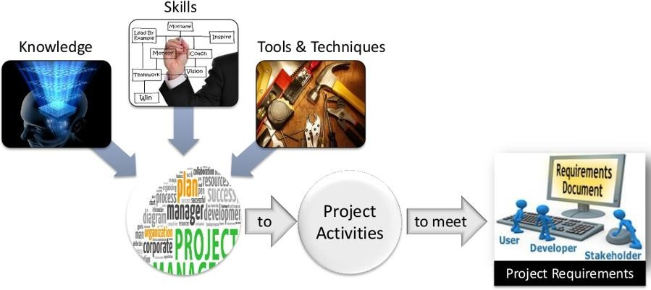
Project Management
The application of knowledge, skills, tools & techniques to project activities to meet project requirements.

Slide 9
Project Management
Advantages
Better control of financial, physical and human resource
Improved customer relations
Shorter development times
Lower cost & Higher profit margins
Improved productivity
Better internal coordination
Higher quality and increased reliability

Slide 10
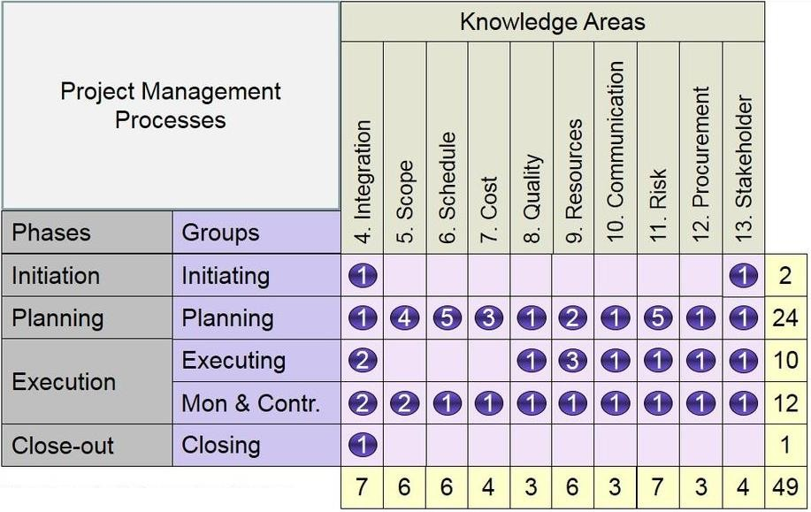

Project Management
11

Slide 11
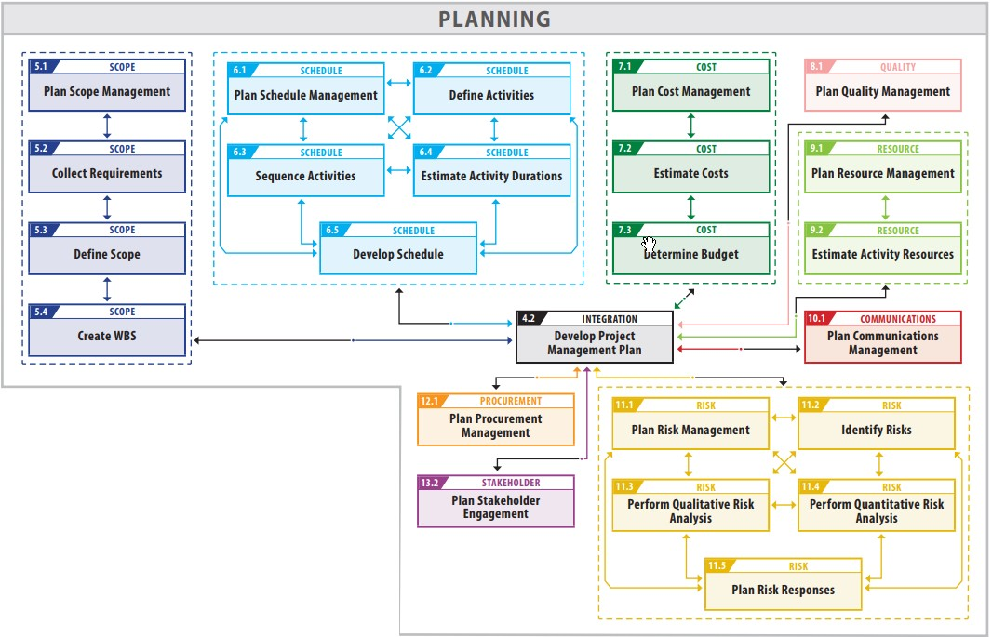
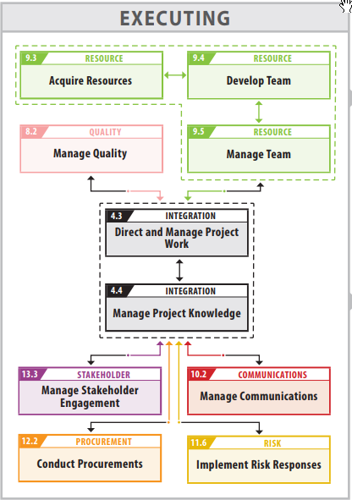

Project Management

Slide 12
Project Management
Project
A project is a temporary endeavor undertaken to create unique product,
service or result
Project Management
The application of knowledge, skills, tool & techniques to project activities to
meet project requirements
Project Manager
The Person assigned by the Performing Organization to lead the team to achieve the project Objectives

Slide 13
2. Program & Portfolio

Slide 14
Program Overview
Is a group of related projects that has related output
Attributes
Decreased risk
Economics of scale
Align projects direction & improve co-
ordination
Focus on inter-dependencies between projects
Need program manager’s coordination and management activities
Program
Sub Program
Project 3
Project 1
Project4
Project
3
Project 2
Project2
Project6
Project7
Project 1

Slide 15
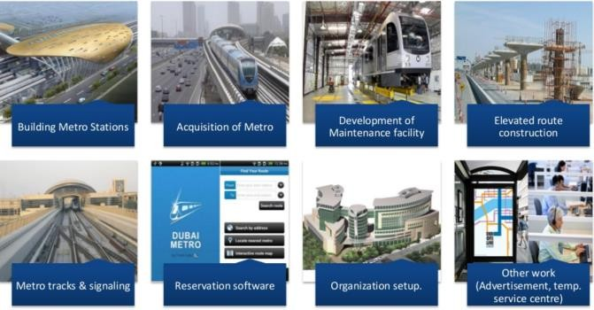
Examples about program

Slide 16
Program Management vs Program Manager
Program Management
The application of knowledge, skills, tool & techniques to program
activities to meet program requirements
Obtain benefits and control not available by Managing Projects individually
Program Manager
Provides leaderships and direction for the project managers heading the project in the program
Focus on Benefits
Decreased risk

Slide 17
Portfolio Overview
Is a group of related program, individual project and other related operation work
Attributes
Project
Sub Portfolio
Program
Portfolio
Project
– Helps achieve specific strategic
Project
business goals, Enhance benefits to
Organization
Reduce risks
Optimize use of resources
Include Operations
Not necessarily directly related
between projects
Program
Project
Operations

Slide 18
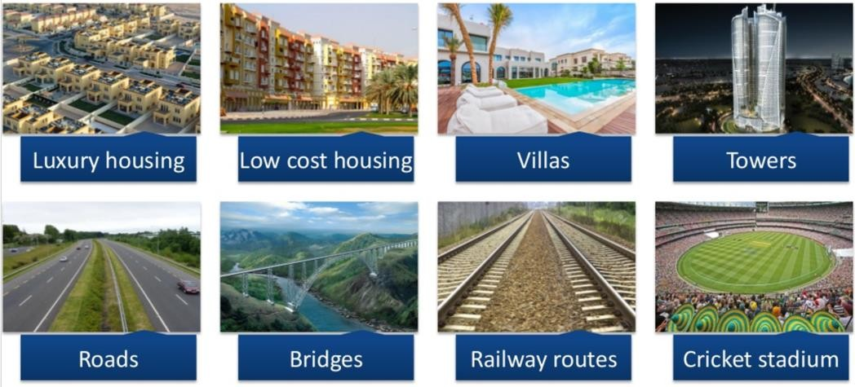
Examples about portfolio

Slide 19
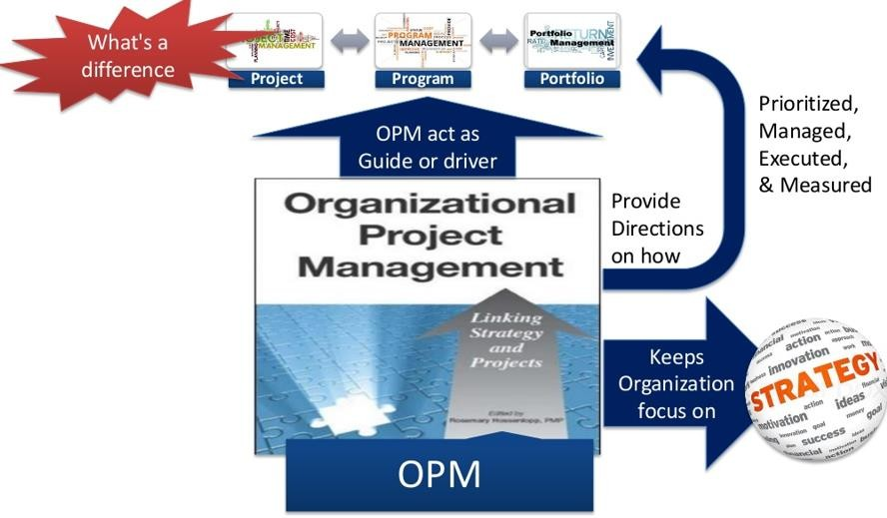
Organizational Project Management
OPM is strategy execution framework
Support practices to consistently and predictably deliver org. strategy
Produce better performance, results, and sustainable competitive advantage

Slide 20
3. Project Management Office (PMO)
09e-BM/DT/FSOFT - ©FPT SOFTWARE - Corporate Training Center - Internal Use
21

Slide 21
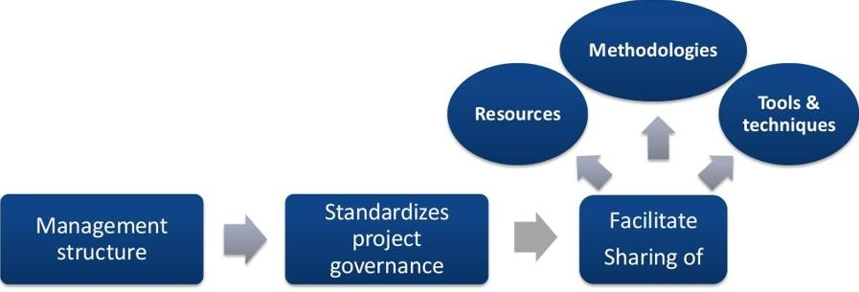
Overview
PMO is a department in the organization. It is a management structure that standardizes project-related governance processes & facilities sharing of resources, methodologies, tool & techniques

Slide 22
Overview
PMO can take one of several different forms:
Supporting
Policies, Methodologies, templates and lessons learned. It has low control.
Controlling
Requires compliance; train others, assist with tools. It has moderate control.
Directive
Provide PM for projects; Takes control; Manage directly; Responsible for result of these projects. It has high control.

Slide 23
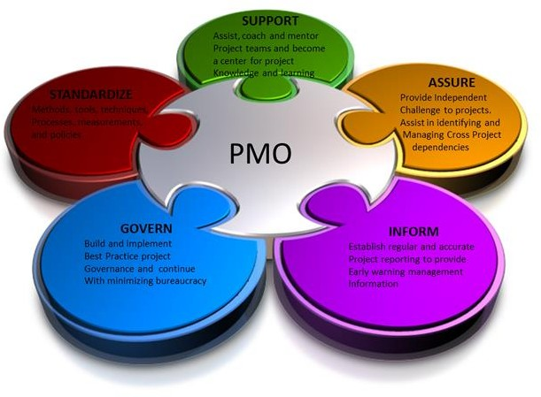
Overview
Identifying & developing Project Management methodology, practices & standards
Monitoring compliance with Project Management standard policies, procedures, and templates via project audits.
Developing and managing project policies, procedures, templates and other shared documentation (organization process assets)
Coaching, mentoring, training and oversight
Coordinating communication across projects
Managing shared resources across all the projects

Slide 24
Overview
More …
Be part of the Change Control Board
Be Stakeholder
Prioritize projects
Recommend the termination of projects when appropriate
Help gather lesson learned and make available to other projects
More heavily involved during project initiating than later in the project

Slide 25
vs Project Manager
PM
Focuses on project objectives
Controls assigned project resources
Manages constraints of individual projects
PMO
Manages major program scope changes to better achieve business objectives
Optimizes use of shared
resource across projects
Manages methodologies, standards, risk/opportunities, metrics & interdependencies

Slide 26
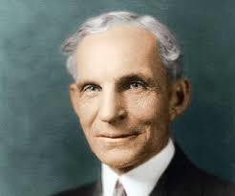
Henry Ford
“Obstacle are those frightful things you see when you take your eyes off your goal.”

Slide 27
4. Operation

Slide 28



Overview
Is on-going endeavors that product repetitive output, with resources assigned to perform same set of tasks according to standards institutionalized in a product life cycle
Decline
Introduction
PLC
Product Life Cycle
Maturity
Growth

Slide 29
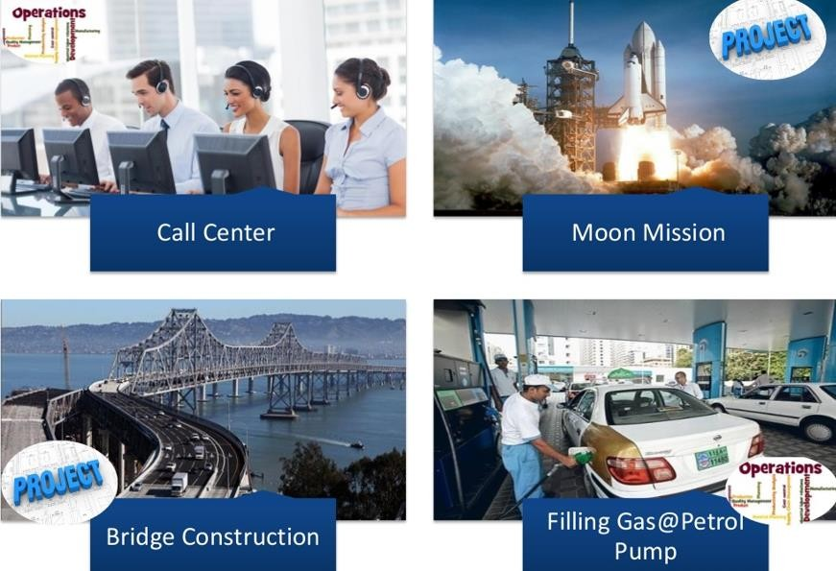
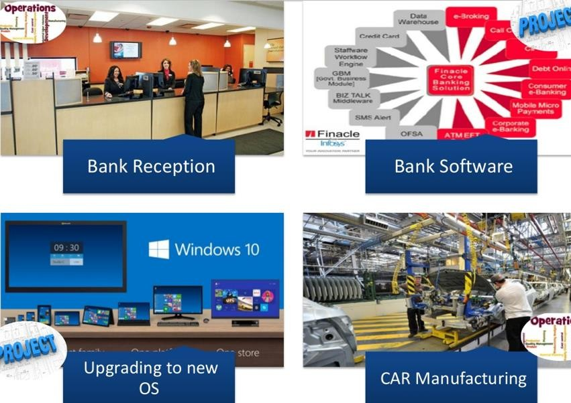
Distinct Project with Operation

Slide 30
Distinct Project with Operation
PROJECT
Attain its objectives and
terminate
Create own character,
organization and goals
Unique product or service
Uses Heterogeneous team
Are Temporary (has start &
end date)
Catalyst for change
OPERATION
Sustain the business
Semi permanent charter organization and goals
Standard product or service
Uses Homogeneous teams
On going activity that
produces repetitive output
Maintain status quo

Slide 31
5. Project Manager

Slide 32
Overview
The person assigned by Performing Organization to lead
team that is responsible for achieving project objective.
Management Skills
Planning
Meeting Management
Time Management
Organizing
Controlling
Interpersonal Skills
Leadership
Communication
Influence
Motivation
Negotiation
Team Building

Slide 33
Overview
Reports to
Functional Manager
Program Manager
Portfolio Manager
PMO Manager
Operation Manager
Works with
Business, System Analyst
Quality Assurance Manager
Subject Master Expert
Vendor, Project Staff
PMO
PM often has lot of responsibility and lacks of real authority. He often negotiate with management/function manager for resources.

Slide 34
Overview
PM need to involve project team members in the planning process.
Identifies and document conflicts of project objectives with organization strategy as soon as possible.
Show consider every processes to determine if they are
needed for individual projects
Must balance the constraints and tradeoff, effectively communicate the info (including bad news) to sponsor for informed decisions

Slide 35
Authority
In control of the project all the time
Authorized to spend the approved project budget
Authorized to make all project execution decisions
Empowered to use resources

Slide 36
6. Organizational influence on Project Management
37

Slide 37
Overview
Organization Culture & Style
Organization Communication Organizational Structures Organizational Process Assets (OPA)
Enterprise Environment Factors (EEF)

Slide 38
Overview
Organization Communication
Project management success is highly dependent on an effective
organizational communication style.
Existing communication culture will impacts projects
Electronic Communication
E-mail
Texting (text chatting); Instant messaging (SMS)
Telephone / Fax
Social media
Video and web conferencing

Slide 39
Overview
Organization Culture & Style
It is a system of shared assumptions, values, and beliefs, which governs how people behave (dress, act, & perform job) in organizations
Examples
Shared visions, mission, values, beliefs, & expectations
Regulations, policies, methods, & procedures
Motivation & reward systems
Risk tolerance
View of leadership, hierarchy, & authority relationships
Code of conduct, work ethic, & work hours
Operating environments

Slide 40
Overview
Organizational structures
It define a hierarchy within an organization.
It identifies each job, its function & where it reports to.
It determines how information flows in the company.
Organization Types
Functional
Projectized
Matrix (Week, Strong, Balanced)
Composite

Slide 41
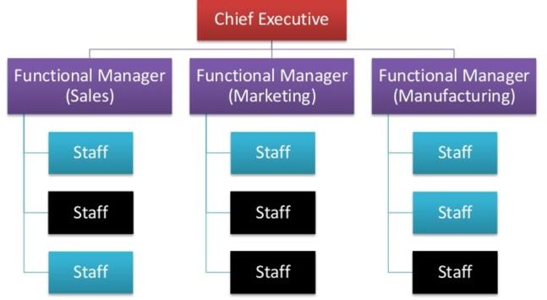
Organization Type
Functional Organization

Slide 42
Organization Type
In functional Organization
Project Expeditor
Staff assistant
Communication Coordinator
Can not make or enforce decisions
Project Coordinator
Similar to Project Expeditor.
Some power & authority to make decisions
Reports to higher level managers

Slide 43
Organization Type
Functional Organization
Advantages
Highly specialized expertise. Easier management of specialists
Resource grouping by
specialties
Clear reporting relationships. Team member reports to one supervisor.
Well defined career path.
Disadvantages
More emphasis of functional specialty, result in harming project.
Difficulty in balancing project
versus real work.
Slow in delivering outcome.
PM has little of no authority.
No career path in project
management.

Slide 44
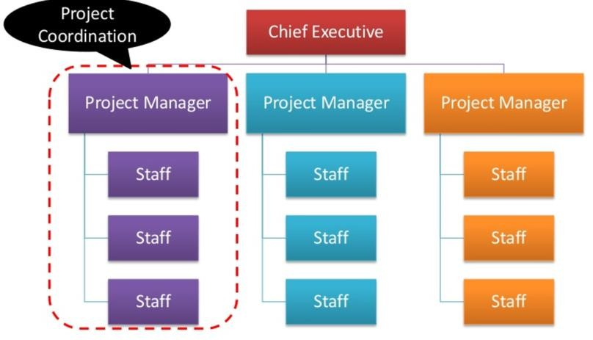
Organization Type
Projectized Organization

Slide 45
Organization Type
Projectized Organization
Advantages
New work /enhancement is
organized by Projects
PM gets resources from different
functions & can hire its own
Team works only on project work
PM has its own full time support staff
PM has full control on budget & Resources, Fully responsible for outcome.
Communication is vertical.
Disadvantages
No home
Duplication of work &
facilitates
In-efficient resource utilization.
Project isolation
Projectitis

Slide 46
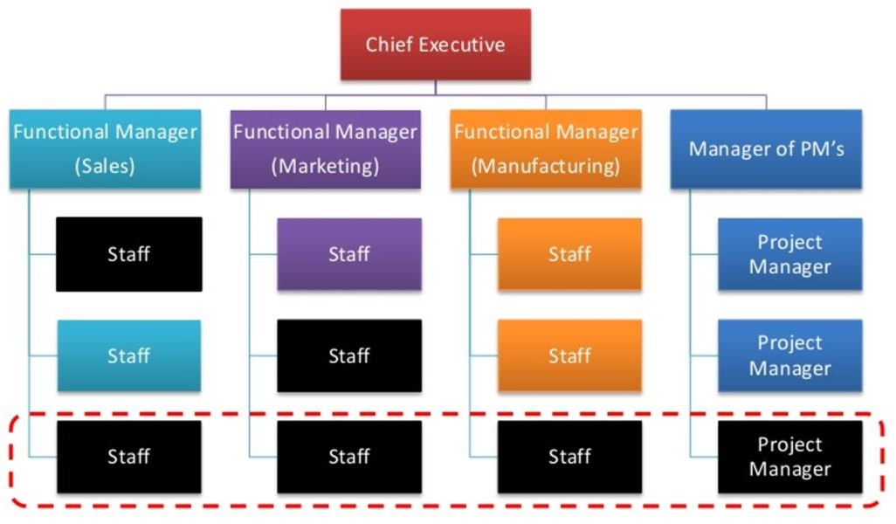
Organization Type
Matrix Organization: Strong, Weak, Balanced
* Tight Matrix: has nothing to do with a matrix organization

Slide 47
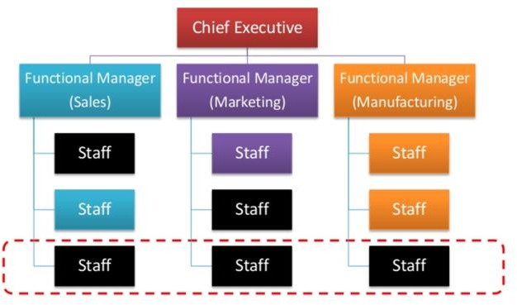
Organization Type
Matrix Organization: Strong, Weak, Balanced

Slide 48
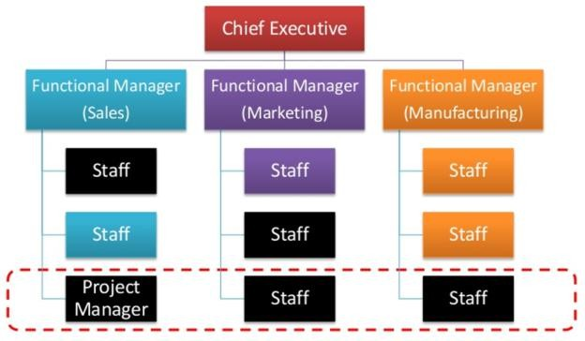
Organization Type
Matrix Organization: Strong, Weak, Balanced

Slide 49
Organization Type
Matrix Organization
Advantages
Efficient resource sharing
Flexible & Dynamic
Focused on Project Goals
Easy team member
reassignment
Disadvantages
Power struggle between PM & Functional Manager
Groupities
Excessive Overhead
How to overcome disadvantages of matrix structure ?

Slide 50
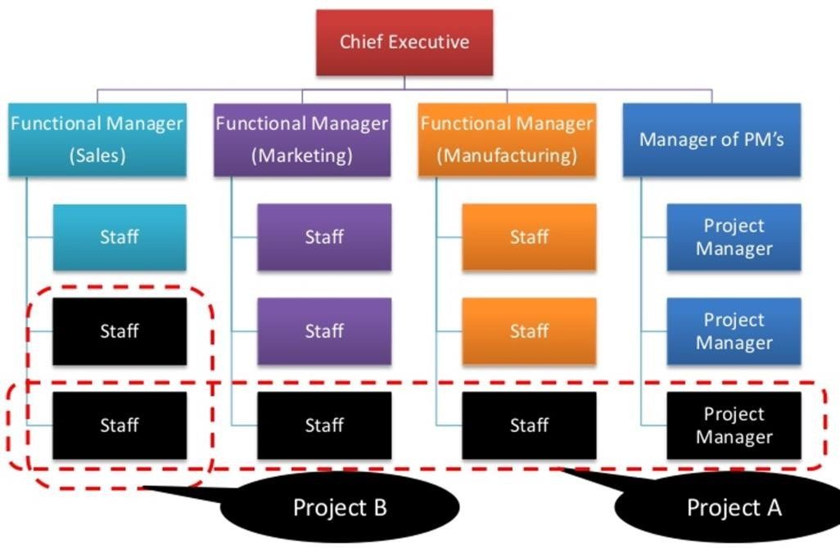
Organization Type
Composite Organization
Very effective resource utilization
High flexibility in meeting requirements

Slide 51
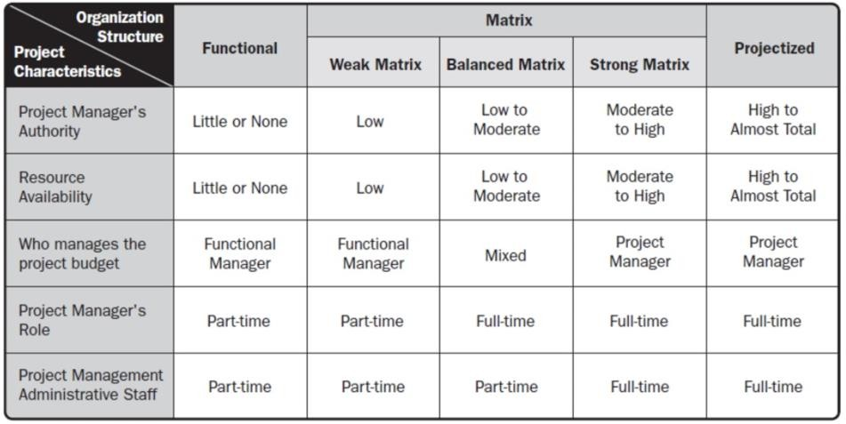
Organization Type
Authority Matrix

Slide 52
Organizational Process Asset
Processes and Procedures
Policies
Procedures
Standard template
Guideline
Corporate knowledge base
Historical information of
projects
Lessons Learnt
Stakeholder Register
Risk Register

Slide 53
Enterprise Environment Factor
It refer to conditions, not under the control of the project
team, that influence, constrain, or direct the project
External Enterprise
Government regulation
Market conditions
Infrastructure
External political conditions
Internal Enterprise
Organizational culture
Type of organizational structure
Internal political conditions
Available resources
PMIS: Project Management Information System

Slide 54
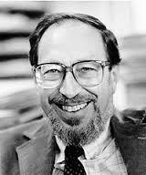
Edgar Schein
“The only thing of real importance that leaders do is to create and
manage culture”

Slide 55
7. Project Life Cycle

Slide 56
Overview
A project life cycle is a collection of project phases. It is a performing organizations or departments project methodology.
– Ex: Software development project phases: Requirement -> Design -> Implement -> Test -> Deployment
Project phase is a collection of logically related project activities that results in one or more deliverables. These are industry specific.
Project Management Process – what you need to do to
mange the work

Slide 57
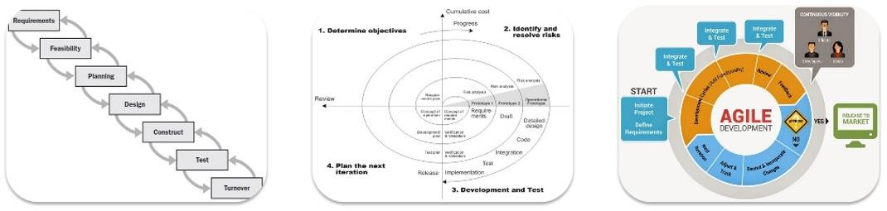
Overview
Plan Driven
Predictive life cycle (Waterfall or traditional life cycle)
Change Driven
Iterative, incremental or adaptive life cycle

Slide 58
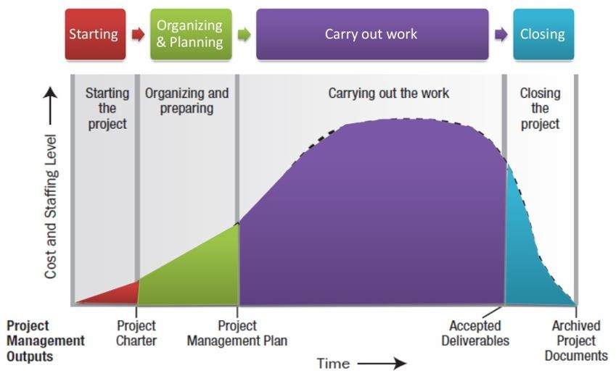
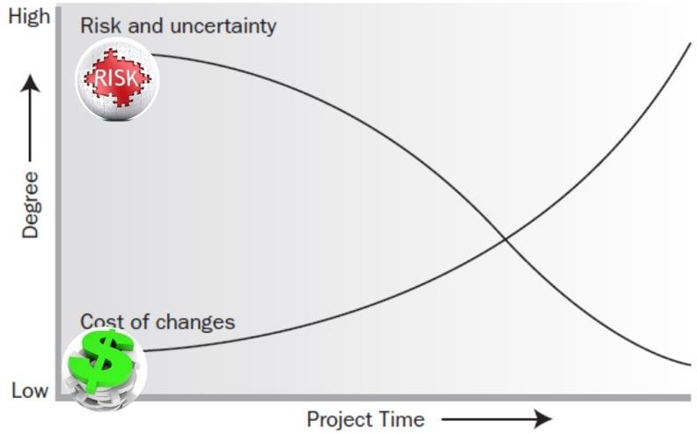
Overview
Characteristic

Slide 59
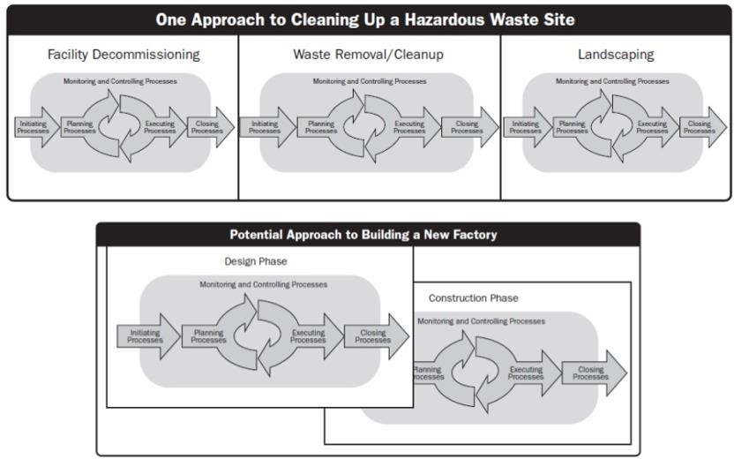
Overview
Phase to phase relationship
Sequential
Overlapping

Slide 60
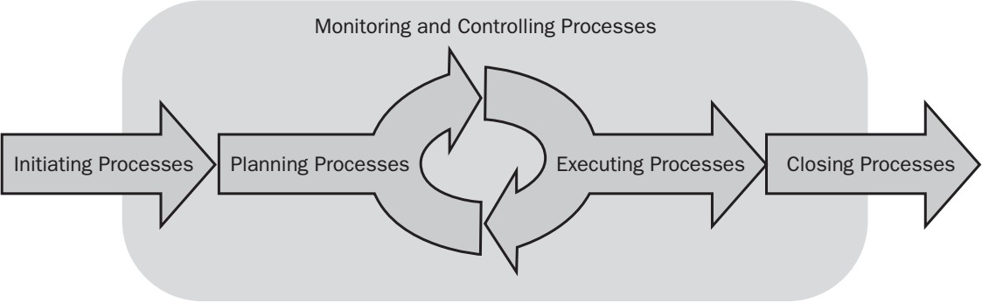
Project Management Process
A management process group (process group) is what you need to do to manage the work
In PMBOK 5th
Initiating
Planning
Executing
Monitoring and Controlling
Closing
Compare with Project Life Cycle?

Slide 61
8. Project Elements

Slide 62
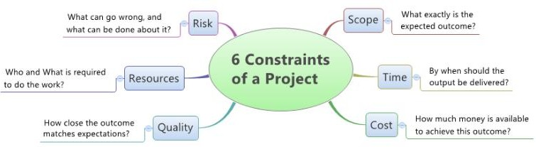
Project Constraints
The 6 project constraints are similar to this 6 legged robot. Each leg represents a constraint, and an issue with any of the constraints may impact the entire project

Slide 63
Project Stakeholder
Stakeholder is an individual, group, or organization who may affect, be affected by outcome of a project.
May be actively involved in the project
May have interests that may be positively or negatively affected by outcome of the project.
Different stakeholders may have competing expectations that might create conflicts within the project
Stakeholders identification is a continuous process.
Stakeholder has varying level of responsibility

Slide 64
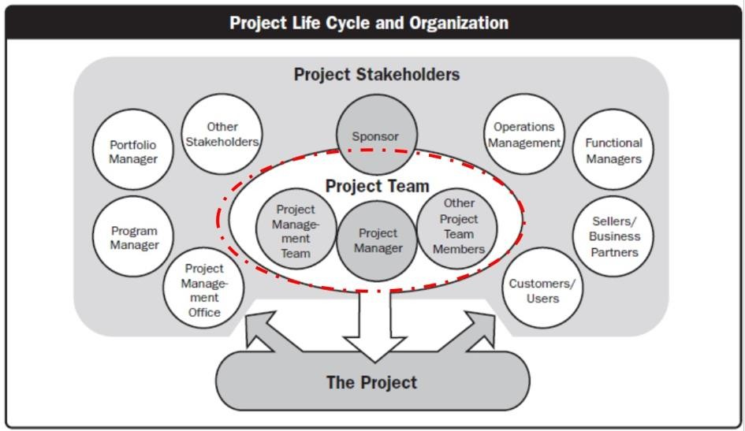
Project Stakeholder

Slide 65
Project Team
Project Team: a set of individuals who support the project manager in performing the work of the project to achieve its objectives. PM is the Leader
Project Management Staff
Project Staff
Supporting
Experts (SME)
User or customer representatives
Sellers
Business partner members
Business
partners
Project Management Office

Slide 66
Project Team
Project Team composition is based on factors such as
Organizational culture, Scope & Location
The relationship between PM & the team varies depending on
the authority of PM
Part- time
Fulltime

Slide 67
Project Governance
The alignment of project objectives with the strategy of the larger organization by the project sponsor and project team.
A project’s governance is defined by and is required to fit within the larger context of the program or organization sponsoring it, but is separate from organizational governance

Slide 68
Project Information
Work Performance
Data
Work Performance
Information
Work Performance
Reports
The raw observations and measurements identified during activities performed to carry out the project work
The performance data collected from various controlling processes, analyzed in context and integrated based on relationships across areas;
A compilation of work performance information for consumption purpose such as status or decision making

Slide 69
Other concept
Project Success
Measured in terms of completing project within constraints of
scope, quality, schedule, budget, resources and risks.
Responsibility of PM
The PM is responsible and accountable for setting realistic and
achievable boundaries for the project .
To accomplish project within the approved baselines
Cost baseline
Schedule baseline
Scope baseline

Slide 70

Nikos Kazantzukis
“In order to succeed, we must first believe that we can.”

Slide 71
Summary
Enterprise Environment Factor
PMIS
Organizational Process Asset
Definition of a project and Constraints
Organizational Structure
Matrix (Strong, Weak, Balanced)
Functional
Projectized
Project-based organization
Organizational Hierarchy
Tight matrix
Project Life Cycle
– Predictive, Incremental, Iterative, Adaptive
Work Performance Data and
Information
Stakeholder Management
Operational work
PMO (Supportive, Controlling, Directive)
Program, Portfolio Management

Slide 72
Next Objectives
What is done during each of the project management process groups
Initiating
Planning
Executing
Monitoring and Controlling
Closing
What you do not do but should do in your real world during each of the project management process groups.

Slide 73

Thank you

